Slide 1
COMP S380F Group Project Presentation
WU Tsz Chung Kimble (11090290), CHEUNG Hoi Man (11182748), Yan Ho Yin (11186213)

Slide 2
Course Discussion Forum System
System design:
Poll
Index page
Poll
Lecture
Lab
Other
Attachements
Message Topics
Attachements
Message Topics
Attachements
Message Topics
Attachements
Message Replies
Attachements
Message Replies
Attachements
Message Replies
Derby Database

Slide 3
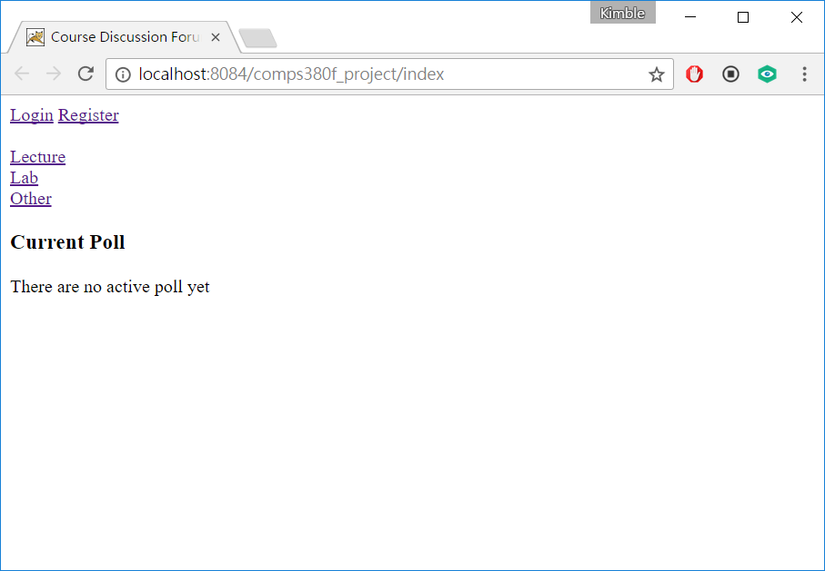
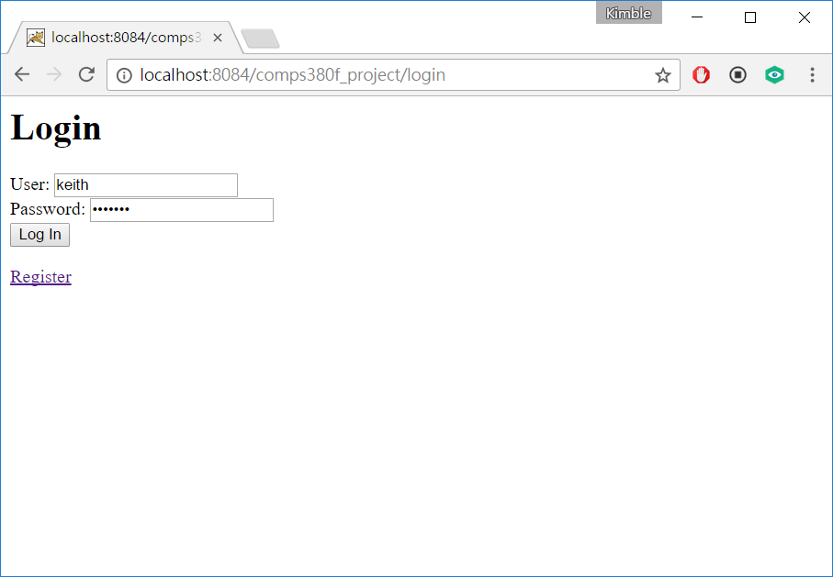
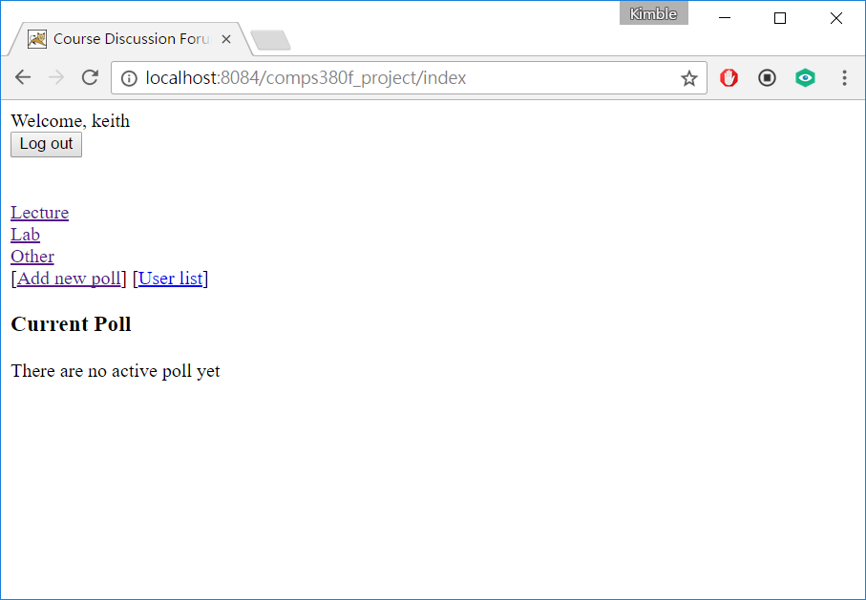
Functions: User Login
Click to login
Enter user info
Login successful

Slide 4
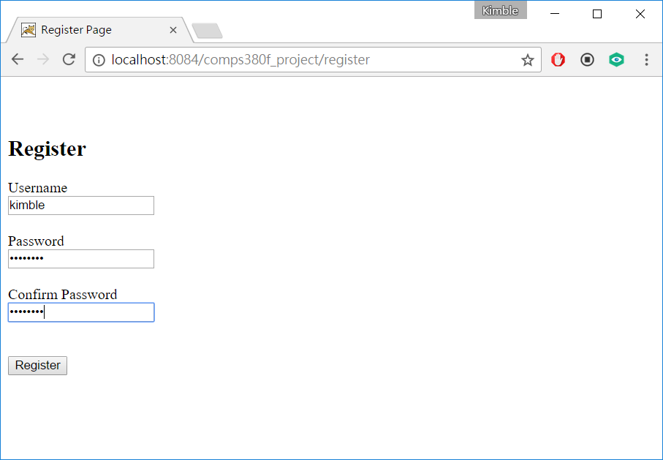
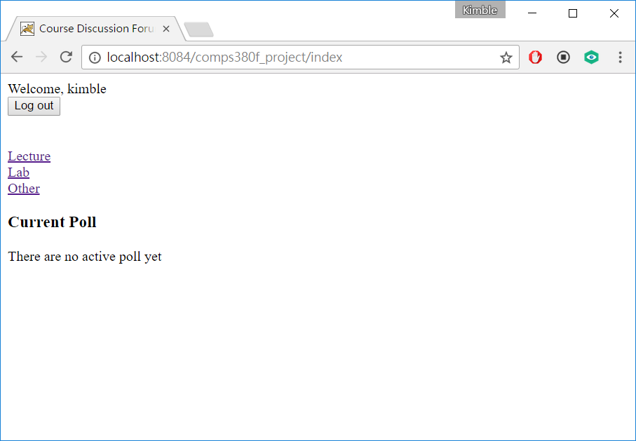
Functions: User Register
Click to register
Create new user
Login as new user

Slide 5

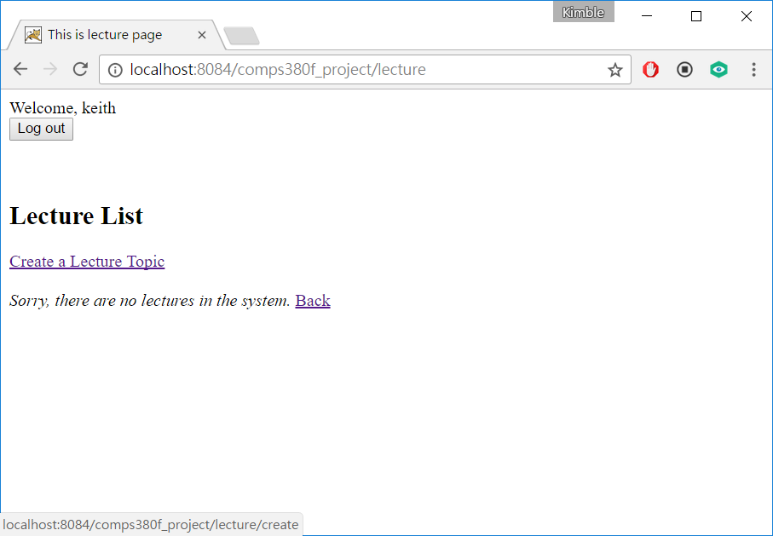
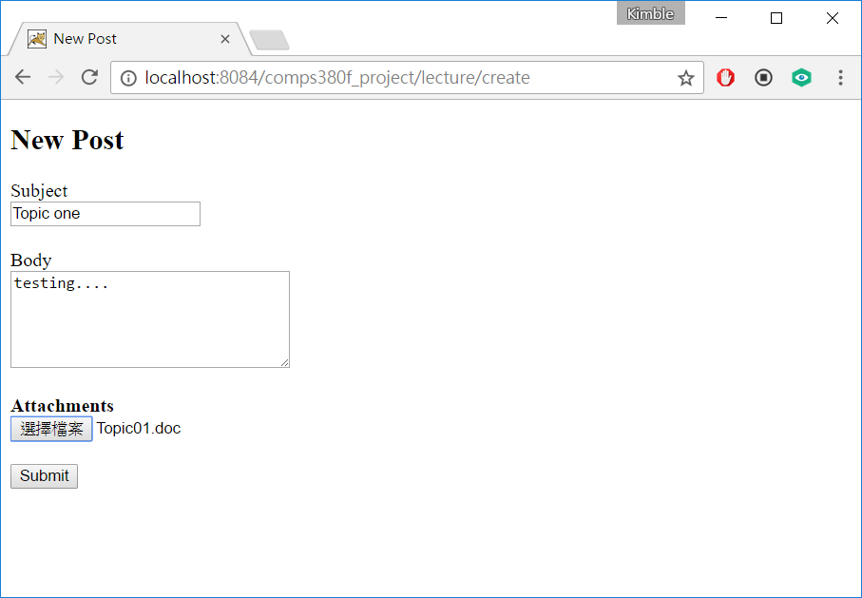
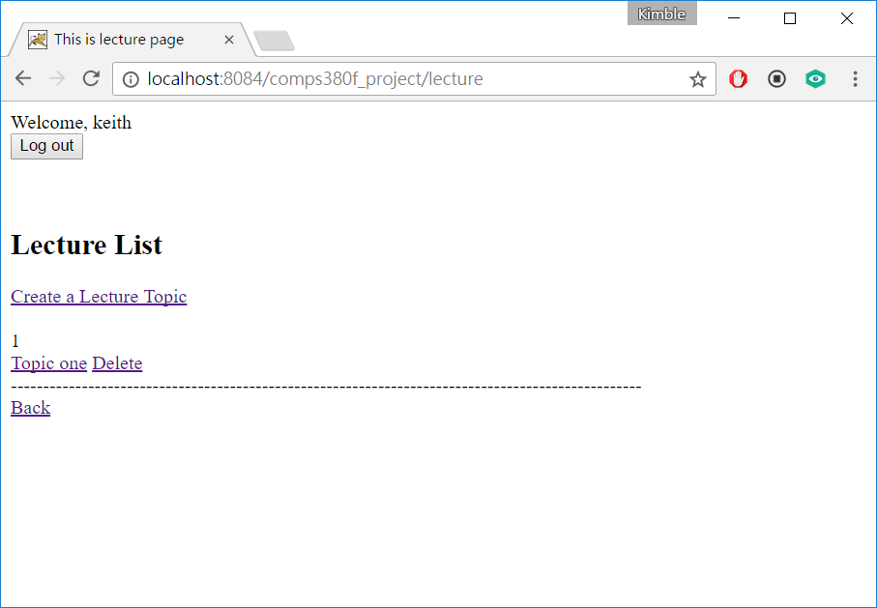
Functions: Message topic
Click to enter a category
Click to create topic
Enter content and upload attachments
A new topic is created.

Slide 6
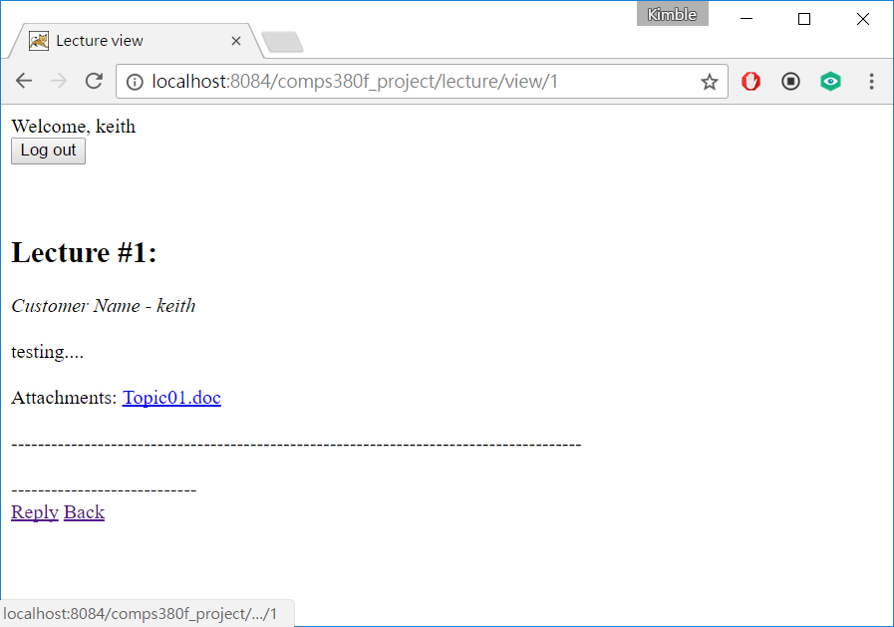
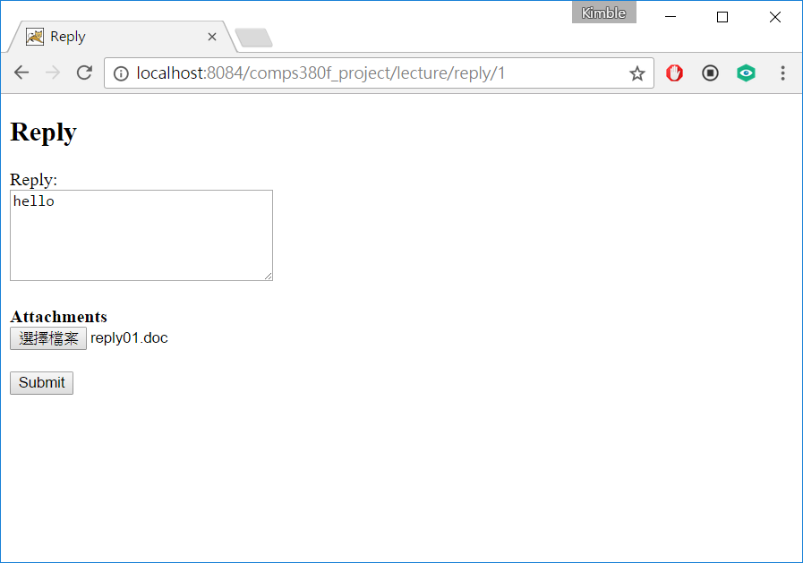
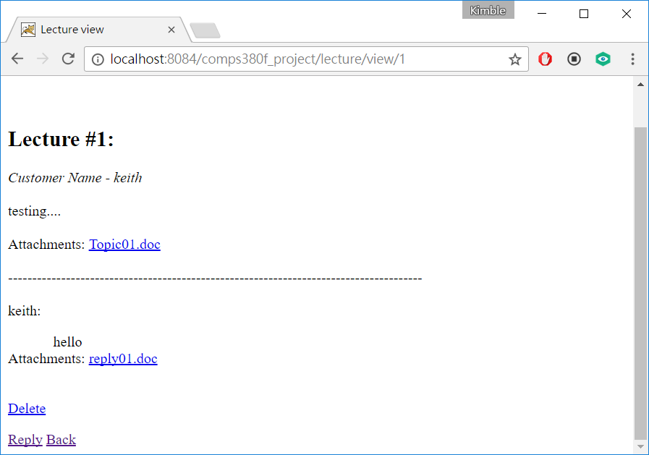
Functions: Message reply
Click to enter a topic
Click to create reply. Attachments can be downloaded.
Enter content and upload attachments
A new reply is created. Attachments can be downloaded

Slide 7
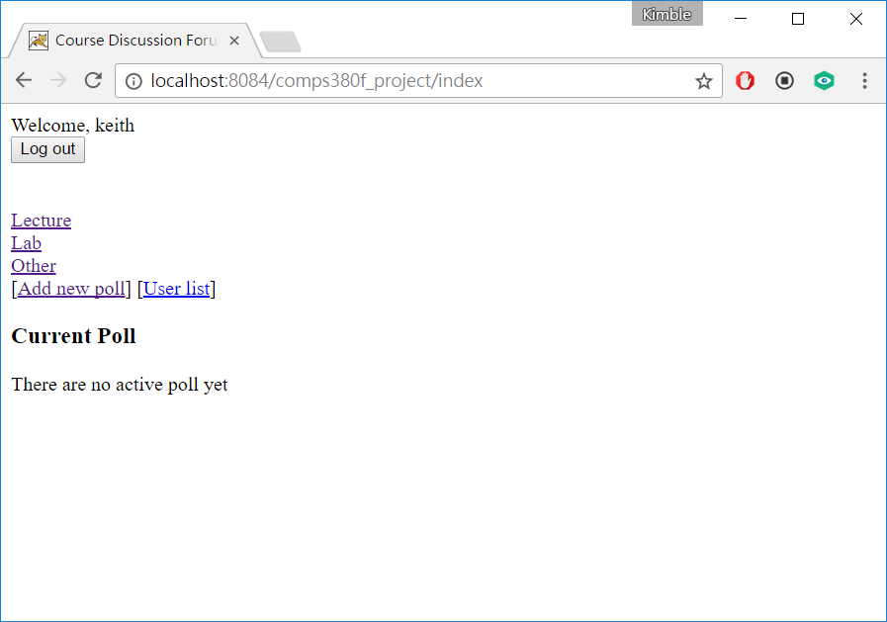
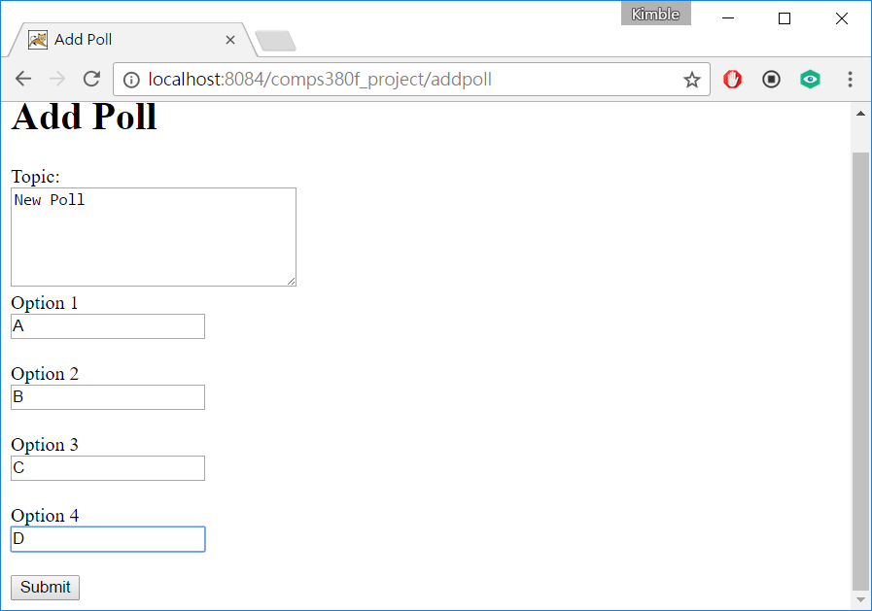
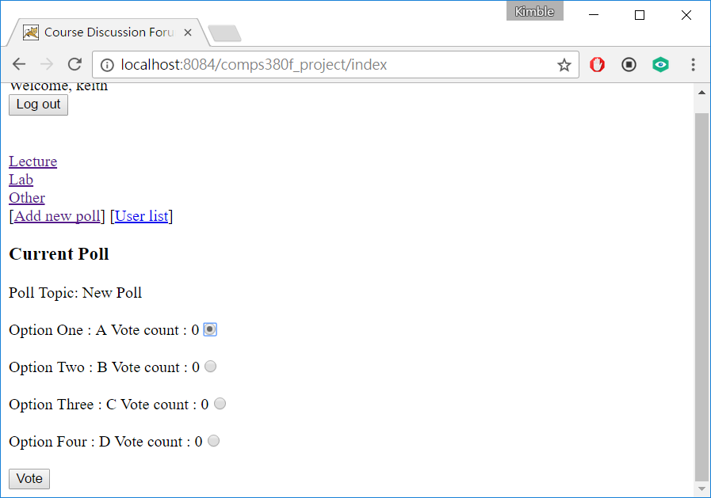
Functions: Poll
Admin can create add new poll
Enter poll content
Users can vote

Slide 8
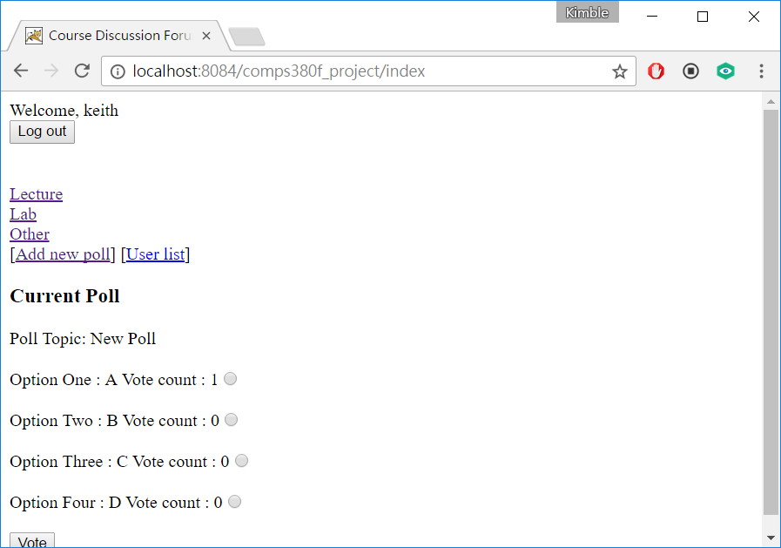
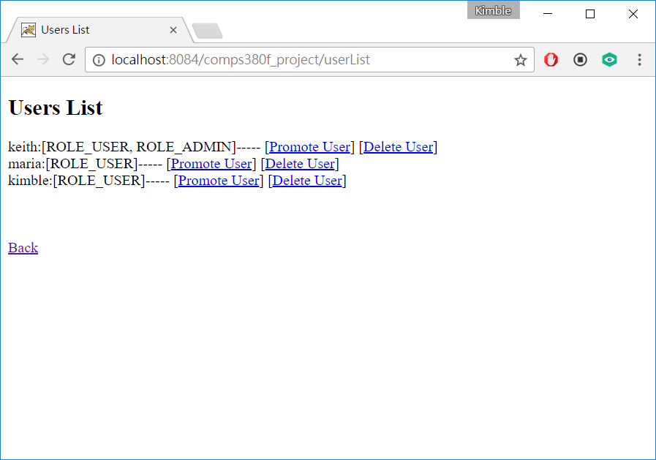
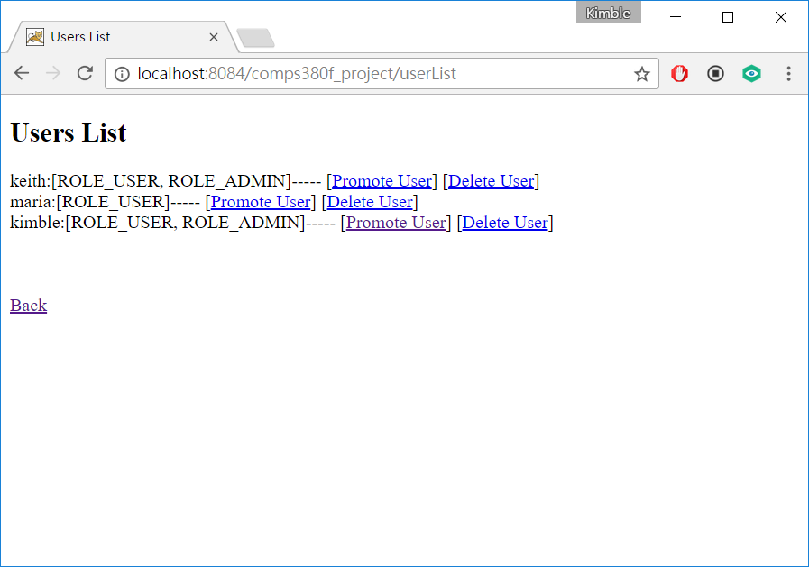
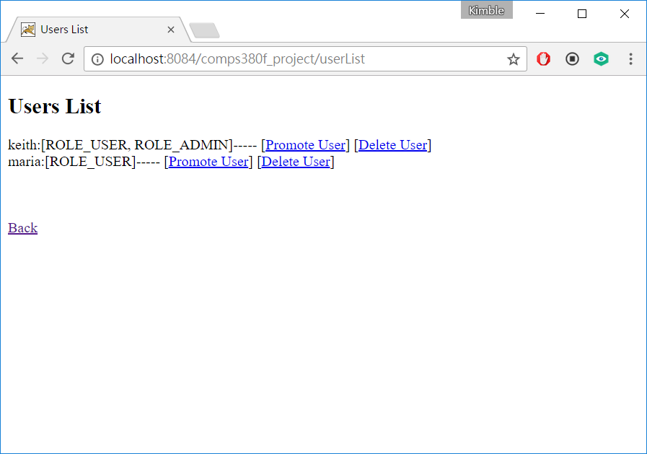
Functions: Users management
Admin can see user list
Admin can promote user to admin and delete user
User promoted
User deleted

Slide 9
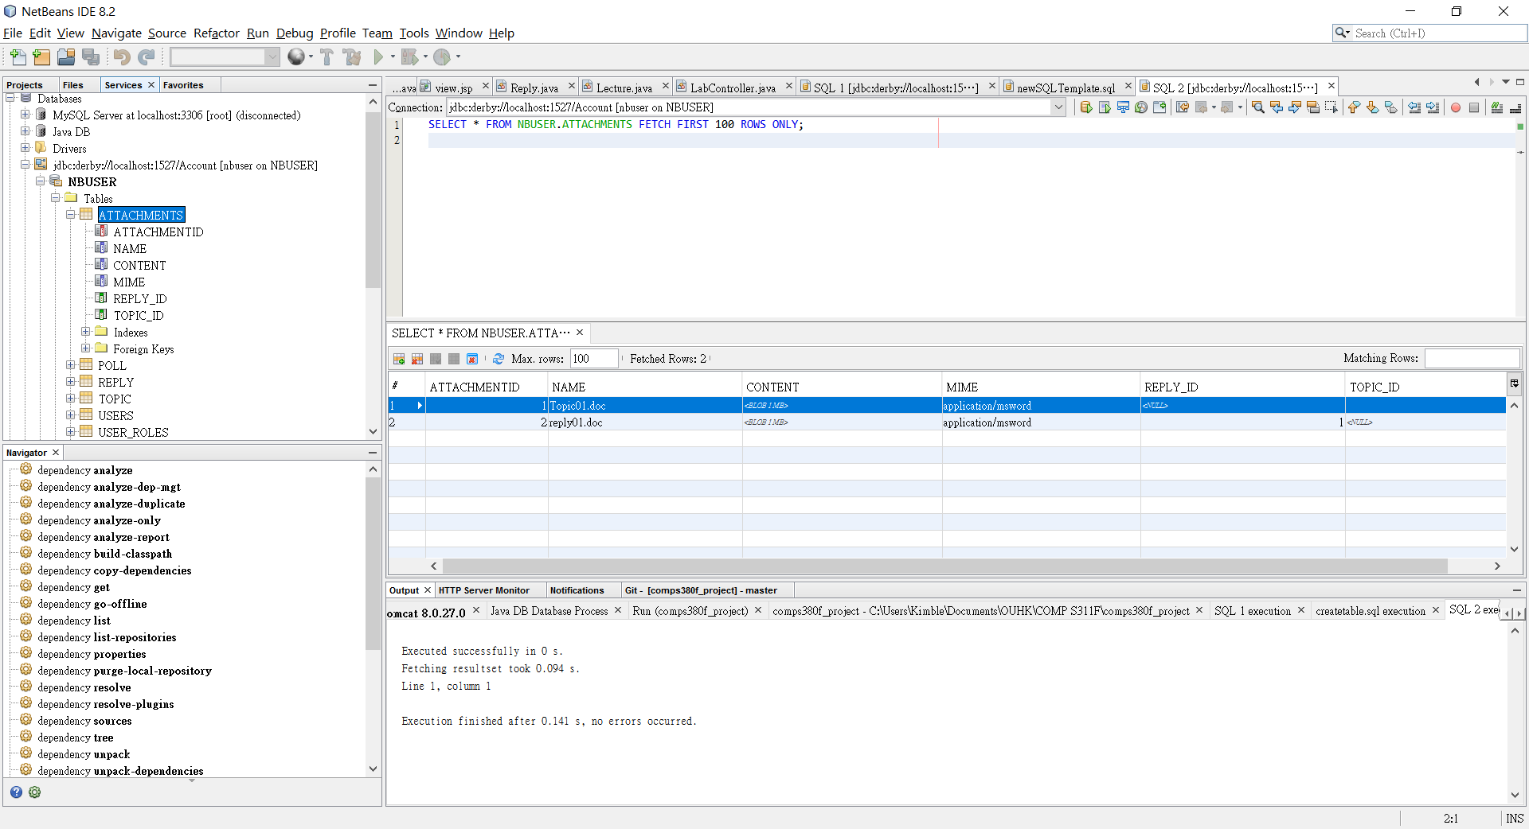
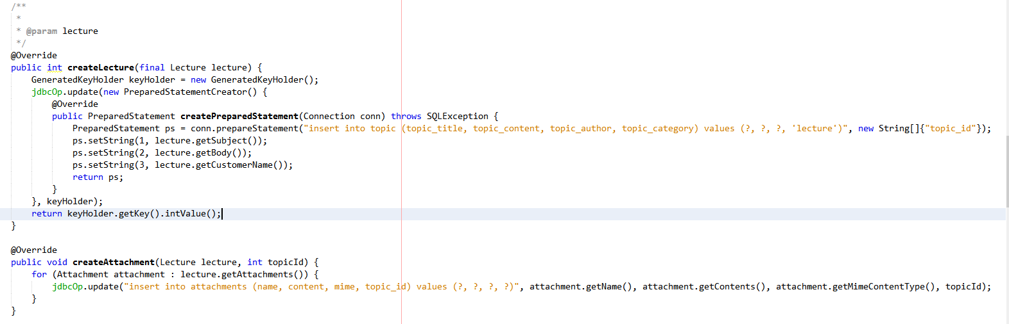
Additional Functions: Store files into database
Attachments are stored into database
Code handling file upload

Slide 10
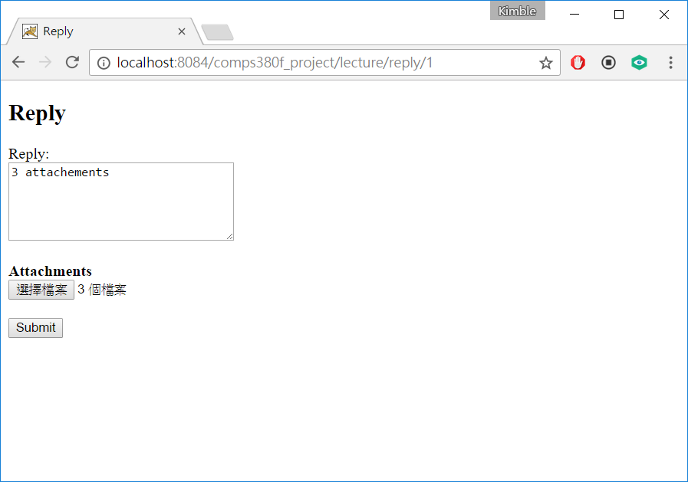
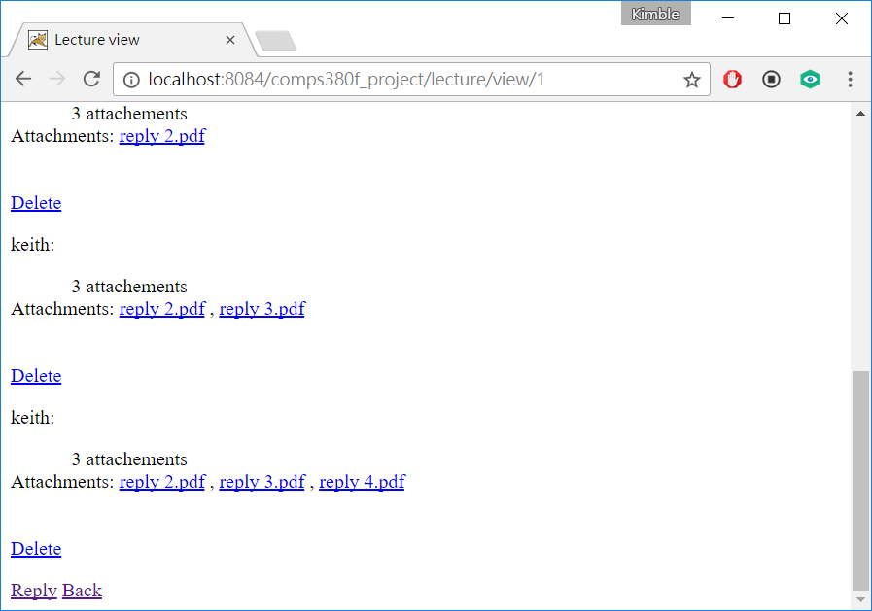
Additional Functions: Uploading multiple files
Uploading multiple files
multiple files uploaded

Slide 11
Technologies used:
Spring MVC web framework
Java EE
HTML5
Derby Database
Netbeans
Chrome

Slide 12
Division of labor
WU Tsz Chung Kimble (11090290): Database control, debugging, Java controller
CHEUNG Hoi Man (11182748): jsp design, debugging, Java controller, Database control
Yan Ho Yin (11186213): Java controller, debugging, jsp design, Database control

Slide 13
Thank you!

